Slide 1
KUBERNETES-BASED ROBOTICS ORCHESTRATION PLATFORM
A SCALABLE, SECURE, AND MODULAR ROBOT CONTROL SYSTEM
By Tatenda Manyepa
Personal AWS Solutions Architect Solution Proposal
March 2025

Slide 2

PROBLEM STATEMENT & OBJECTIVE
Legacy robot control systems hinder scalability, efficiency, and integration across vendors.
This project aims to design a modular, cloud-native platform using Kubernetes and Terraform to solve these challenges.

Slide 3
CURRENT CHALLENGES
Slowness and inefficiency from monolithic design
High-latency communication
Lack of flexibility and reusability
Vendor lock-in and poor integration
Limited scalability
Insufficient security and observability

Slide 4
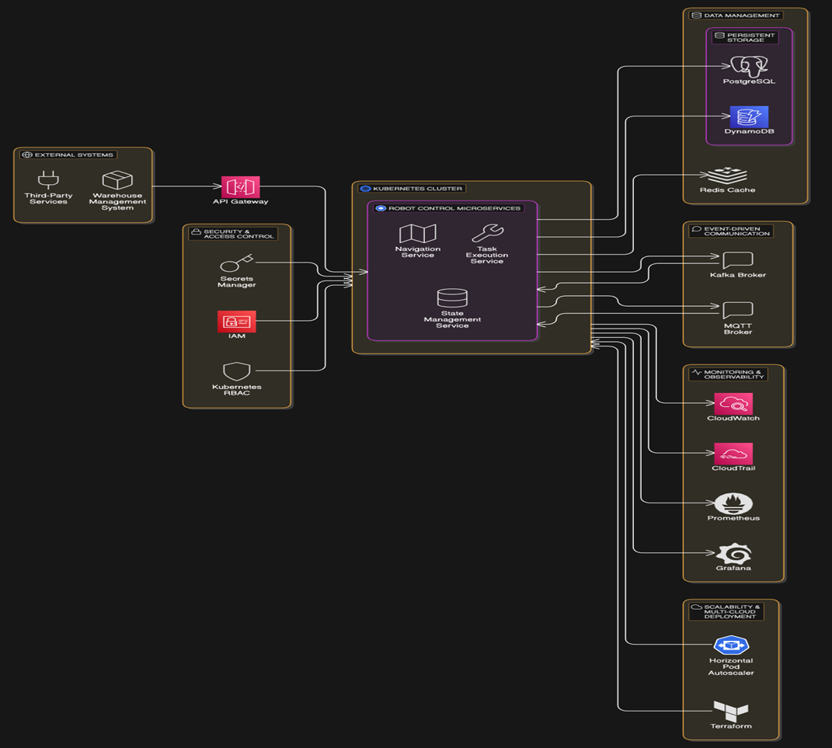

Slide 5
KEY AWS SERVICES
Amazon EKS (Kubernetes)
AWS Secrets Manager
Amazon CloudWatch
IAM and Role Based Access Control
Dynamo DB/Redis
AWS Application Load Balancer/ Network Load Balancer

Slide 6
Modular microservices for independent scaling
Industry-agnostic design for healthcare, logistics, etc
Terraform enables multi-cloud, multi-region deployment
Kubernetes Federation supports geo-distributed workloads
SCALABILITY, FLEXIBILITY, AND REUSABILITY

Slide 7
BUSINESS IMPACT
  Faster robot response times
  Automated scalability
  Improved security and observability
  Cross-industry reusability
  Reduced downtime and improved adaptability
COST ANALYSIS AND TRADE-OFFS
  Cost for running Kubernetes clusters
  Learning curve for Kubernetes & Terraform
  Terraform helps mitigate vendor lock-in
  Edge computing adds complexity but reduces latency

Slide 8
CHALLENGES & CONSIDERATIONS
  Complex Kubernetes networking
  Need for specialised expertise
  Managing cost of persistent clusters
  Adopting service mesh and monitoring tools
FUTURE ENHANCEMENTS
  AI for robot task optimisation and anomaly detection
  Hybrid Edge + Cloud deployments (K3s)
  Serverless integration using AWS Lambda

Slide 9



THANK
YOU
“This solution offers a modern alternative to legacy robot control systems, enabling scalable, secure, and real-time orchestration across diverse robotics environments using Kubernetes and Terraform”.
+447932793775
https://cloudportfolio.co.uk/

