Slide 1
AWS CI/CD PIPELINE WITH SECURITY BEST PRACTICES
MODULAR AND REUSABLE ARCHITECTURE
By Tatenda Manyepa
Personal AWS Solutions Architect Project
January 2025

Slide 2

PROJECT OVERVIEW
•A secure, automated CI/CD pipeline using AWS services to ensure fast, reliable, and secure software delivery
•Built using AWS CodePipeline, CodeBuild, CodeDeploy, IAM, and Secrets Manager.
•Modular design enables reuse across different development workflows.

Slide 3
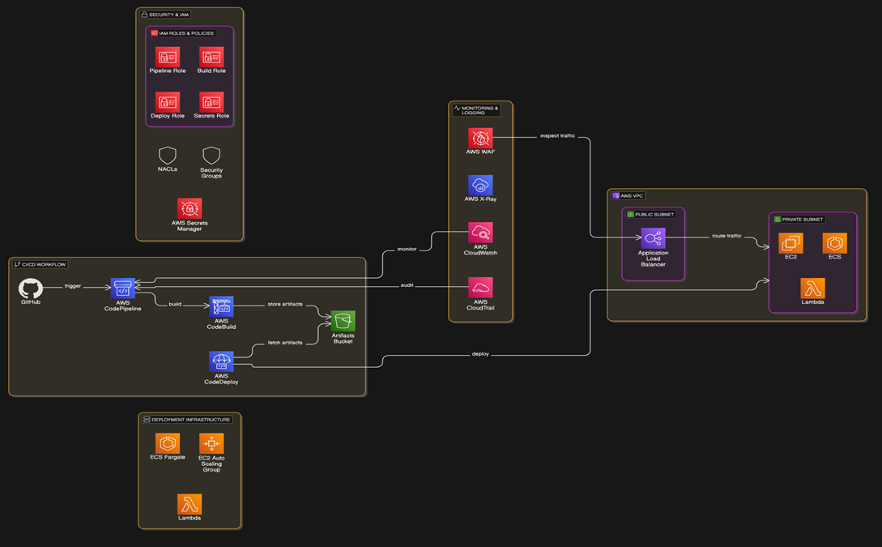
ARCHITECTURE DIAGRAM

Slide 4
ARCHITECTURE FLOW SUMMARY
"Each service was selected to meet high availability, security, and operational efficiency requirements."
Code pushed to GitHub triggers pipeline
CodeBuild compiles and tests the code
Artefacts stored in S3
CodeDeploy deploys to EC2, ECS, or Lambda
Monitored with CloudWatch, CloudTrail, and X-Ray
Auto Scaling & Fargate for flexibility

Slide 5
STEP-BY-STEP IMPLEMENTATION
Configure IAM Roles with Least Privilege
Integrate GitHub or CodeCommit
Define CI/CD Stages in CodePipeline
Configure CodeBuild with security best practices
Set up CodeDeploy for automated deployment
Enable CloudWatch and CloudTrail monitoring

Slide 6
Reusable across serverless, containerised, and EC2-based environments.
Examples:
E-commerce: Fast deployments
Finance: Secure & compliant releases
Healthcare: HIPAA-ready rollouts
SaaS: Continuous feature delivery
REUSABILITY AND INTEGRATION

Slide 7
RESULTS AND IMPACT
  Deployment reduced from hours to minutes
  Automated testing improves reliability
  Enhanced security and scalability
  Faster time-to-market
CHALLENGES AND SOLUTIONS
  Agent Connectivity: Restarted, verified IAM
  Missing Files: Fixed appspec.yml and artefacts
  SSH Issues: Corrected key permissions
  Node.js Missing: Installed on EC2
  BeforeInstall Failures: Debugged scripts

Slide 8
PIPELINE OPTIMISATION TECHNIQUES
Use
Use build caching and larger build instances
Combine
Combine commands to reduce steps
Optimise
Optimise artefact packaging
Use
Use Docker in CodeBuild
Parallelise
Parallelise pipeline stages
Tune
Tune EC2 instance and AMI performance

Slide 9



THANK
YOU
"This CI/CD pipeline architecture offers a secure and modular foundation for modern application delivery, enabling speed, security, and flexibility across various deployment models using native AWS services."
+447932793775
https://cloudportfolio.co.uk/

